Slide 1
Stars and Fans
Beatlemania & Pathology

Slide 2
Fan
Two origins
Latin fanaticus (enters English 1550), fanum
Fancy=fans of specific hobbies or sports, especially boxing (l.18th e. 19th centuries)
Shortened to fan
Celebrity fandom explodes in the 20th c.
Mass media the prime reason

Slide 3
20th C. Music Fans
Crooners
Bobby soxers or jitterbuggers
Elvis fans
Beatlemaniacs
Boy band fans
Largely young and female
Often criticized in the media

Slide 4
Crooners
Coincides with the advent of electronic recording (powered microphones)
Rudy Vallee became the most popular (1928)
Style of singing that depends on electric microphones; accentuates vocal warmth
Voices shifted from tenor (Vallee) to baritone (Russ Columbo & Bing Crosby) in 1930s

Slide 5
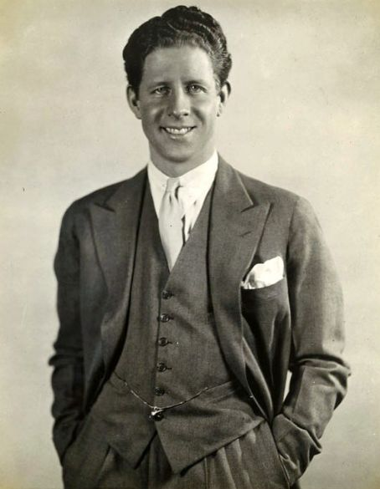

Slide 6
Bobby Soxers
Coincide with rise of swing music
Also known as jitterbuggers
Shifted music fandom to kids
Coincides with rise of teenage culture
Most successful was Frank Sinatra
Also included Perry Como, Dean Martin, Tony Bennet

Slide 7
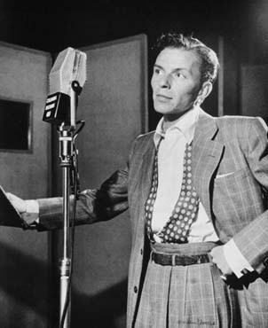

Slide 8
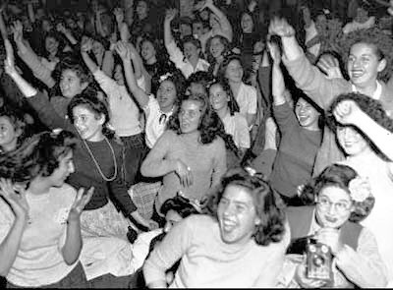

Slide 9
Elvis Fans
Strong working class identity
Female fans, largely young & white
Elvis seen as “dangerous” bad boy
Screaming fans add to this idea of danger
Also seen as dutiful son
Army service changes his image

Slide 10
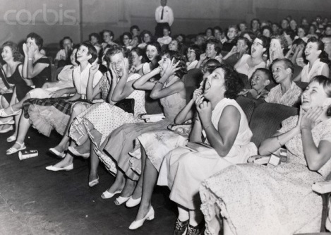

Slide 11
Beatlemaniacs
Large numbers due to Baby Boom
Cuts across class lines
Beatles seen as anti-heroes
Long hair implies androgyny in US
Organized fan clubs
Article implies they’re proto-feminists

Slide 12
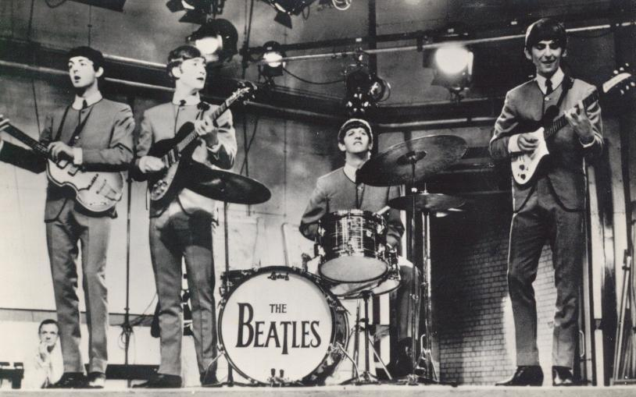

Slide 13
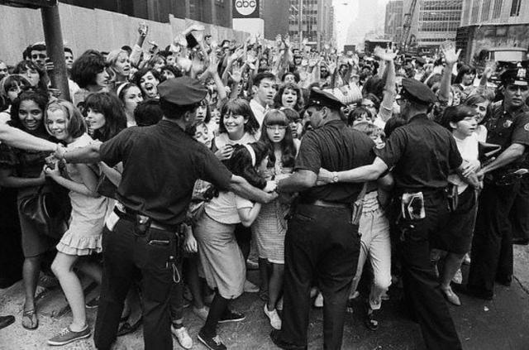

Slide 14
Ehrenreich, et al.
Argue that Beatle fans had much to rebel against
Largely, the sexual double standard
They argue that the screaming and fainting was a rebellion against this
They assert that this was the first uprising of the women’s sexual revolution
Problematic, historically

Slide 15
Baby Boom
Largest generational cohort in US history
Post-war affluence also important
Ehrenreich, et al. confuse size of crowds with a new phenomenon
The girls don’t say they’re rioting against the sexual double standard, historians do
Middle class fans is the real issue
Elvis fans were working class

Slide 16
Economics & Beatlemania
Post-war affluence creates a larger middle class
Baby boom creates a larger society
Middle class women/girls largely confined to the domestic sphere
Little status in being a career woman
Commodification of female sexuality nothing new, just more women/girls now

Slide 17
Boy Bands
Teen heartthrobs & boy bands
1950-present
Have become much more marketed
Fans are youngers, tweens
Some girl artists (Debbie Gibson & Brittany Spears)
A huge industry

Slide 18
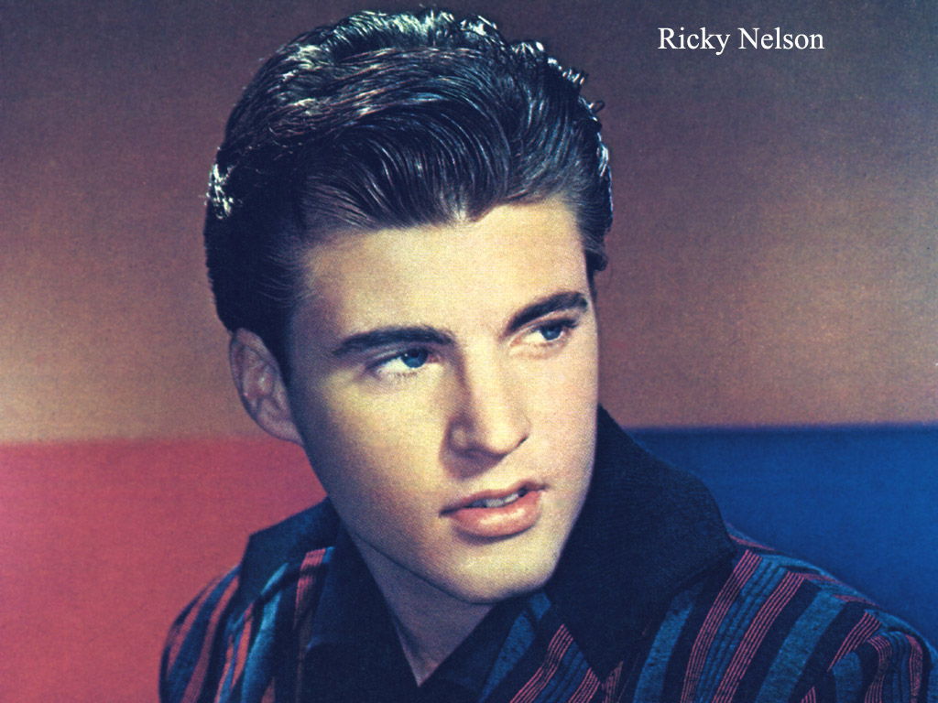

Slide 19
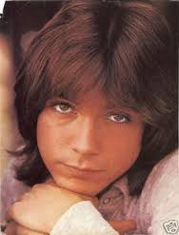

Slide 20
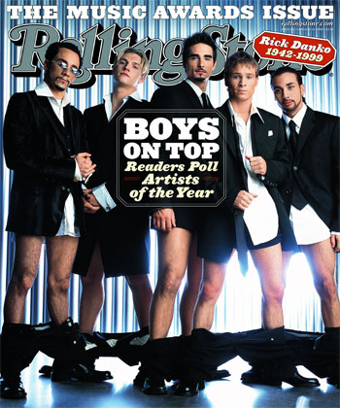

Slide 21
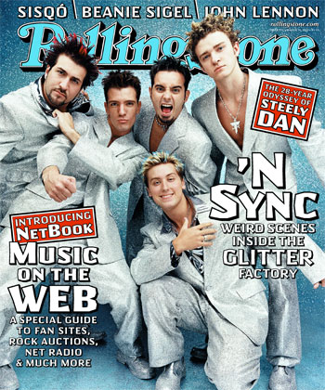

Slide 22
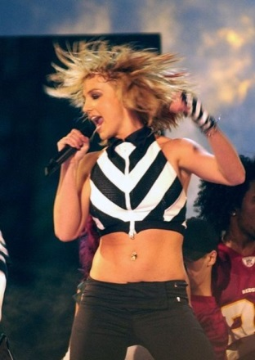

Slide 23
Fandom As Pathology
The obsessed individual
The hysterical crowd
Based on a critique of modern life
Fandom seen as social dysfunction
Once fans are deviates, they can be treated as disreputable or dangerous
“us vs. them” dichotomy created

Slide 24
Fan Culture & Class
Reputable vs. disreputable
Patrons, aficionados, collectors = reputable
Favor “high” culture; opera, literature
Fans who favor “low” culture, seen as disreputable; monster trucks, romance novels
More useful are “elite” and “popular”
Money is a large determiner of reputation in fandom

Slide 25
Which came 1st, the fan or the star?
Cannot exist without each other
Currently, fans are seen as a response to the star system
The mass media created the fan, according to modern constructions
Easy to link obsessive behavior to fans
The obsessed loner
The hysterical crowd member

Slide 26
Critiques of Modern Life
Obsessed loner=alienation & atomized “mass culture”
Hysterical crowd=vulnerable victim of mass media persuasion
Critiques of modernity
Materially advance but threatened spiritually
Largely nostalgia
The past had its problems, just different ones

Slide 27
The Decline of Community
Communal bonds offer protection, identity, & connection
Loosening of these bonds creates vulnerability and destroys a reliable orientation
Irrational appeals, especially those offered by mass media, are easier to believe
Past experiences with propaganda encourage these beliefs

Slide 28
Obsessed Loner
Cut off from family, friends, society
Turns to unhealthy & obsessive fixations on stars
Mass media provides the access to the stars
Eventually, the line into pathology is crossed
Danger & violence are the result

Slide 29
Hysterical Crowd
As a member of the crowd, the fan becomes irrational & easily influenced
Very gendered construction
Females cry, scream & faint
Males drink too much, are destructive & violent
A critique of modernity

Slide 30
Class Elements of Fan Construction
Rock music fans are dangerous
Opera fans are not
Crazy fans are “them”
Objects of desire decide identity of fans
Modes of enactment
Access, usually based on money, decides whose fandom is “normal”
Cultural hierarchy

Slide 31
Excess
Fandom involves excess & emotional displays
Affinity involves rational evaluation & more measured displays
Valuing the genteel over the rowdy is based on status
Status, in this case = class distinctions
Reason favored over emotion

Slide 32
Consequences
Stigmatizing=scapegoating
Offers reassurance that “we” are ok, “they” are not
Thus, the world is safe if there is an us & them
Also allows status enhancement for “us”
Way to enforce power structures based upon money & class

